Slide 1

OpenStreetMap rendering on Android
Computer Science Institute
Freie Universität Berlin

Slide 2
Agenda
Quick introduction of mapsforge
OpenStreetMap on Android
Our approach to mobile map rendering
Our free map library for Android
Our free map application for Android
Hello, MapView
What comes next
Questions and live demo

Slide 3
About mapsforge
The mapsforge project
  initiated at the computer science institute
  of Freie Universität Berlin
  was started in 2008
  provides free mapping and navigation tools
  is based on OpenStreetMap and free software
  currently involves 10 students and scientific staff
  since April 2010 at Google Project Hosting
  uses the GPL3 license for all source code
http://mapsforge.org

Slide 4
What we do
Creating various tools for
  Map rendering
  Route planning
  POI indexing and search
  Spatial data formats and algorithms
Focus is on mobile devices
  Currently only Android
  In the future also other platforms
We aim for maximum flexibility
  Configurable map extraction and rendering
  Configurable navigation and routing
  Online and offline services

Slide 5
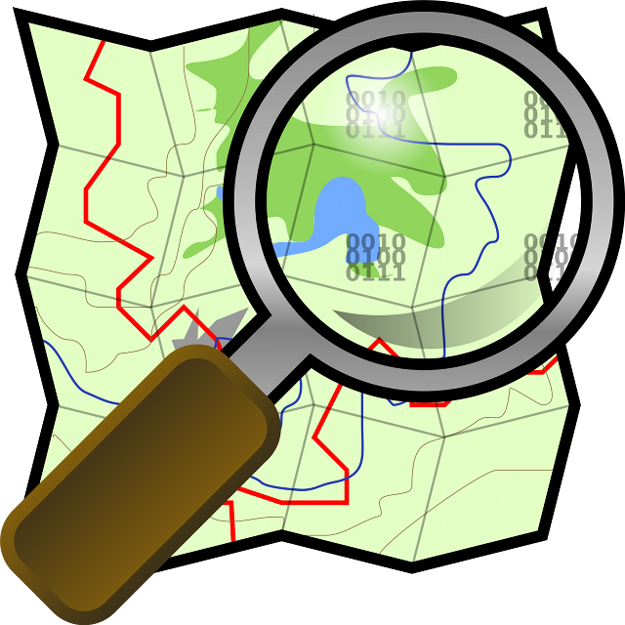
OpenStreetMap on Android
The OpenStreetMap (OSM) project
  Creative Commons license
  Map data can be downloaded as XML files
  Rendered tiles available as PNG files
Many applications for OSM on Android exist
  Not all of them are free software
  Only few can work completely offline
  Only very few render map images on the device
Advantages of rendering OpenStreetMap offline
  No internet connection required
  Saving money and privacy
  Much more flexible than static tiles

Slide 6

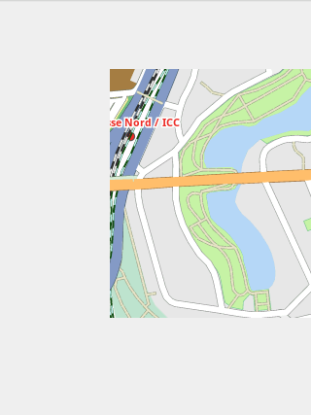
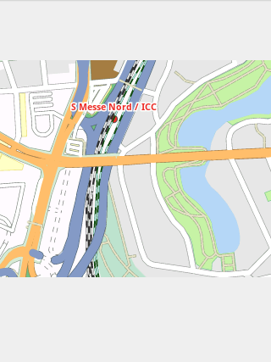
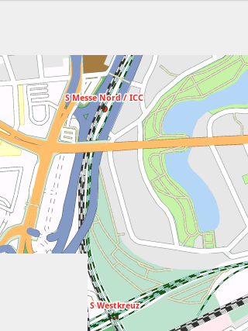
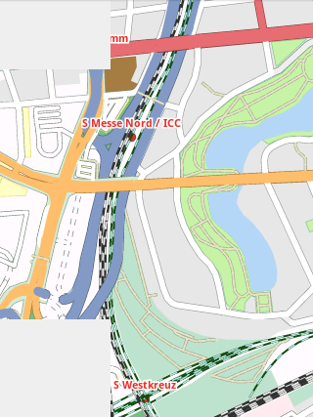
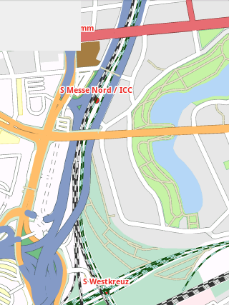
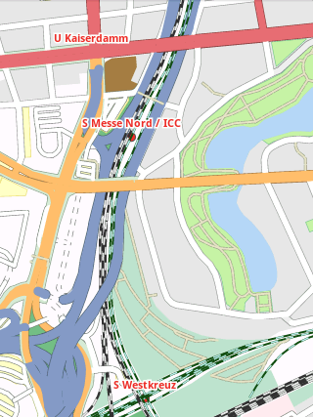
Our approach to mobile map rendering
All map data is stored on the device
  Preprocessing of OSM data with a converter
    Input: Raw OSM map data (Berlin: 167 MB)
    Output: Single binary file
    (Berlin: 15 MB, full details including names)
    No pre-rendering of images or tiles
    Finally the map file is copied to SD card
Tile based rendering
  Tile = small, rectangular part of a map
  De facto standard for online maps
  Advantages
    Incremental map rendering
    → better user experience
    Allows caching
    → higher frame rate

Slide 7



Challenges of mobile map rendering
Rendering a map tile is difficult
  Get all map data that intersects it
  Correct handling of overlapping map objects
  Fast but accurate map projection
  Filter map objects by zoom level
  Collision free label placement
  Scheduling of all required tiles
  …
Android specific challenges
  Only 16 MB of RAM per process
  Optimization for Dalvik VM
  Avoid garbage collection
  Multiple Android versions and devices

Slide 8
Our free map library for Android
Library for rendering map tiles on different zoom levels
  Implements important classes and methods from the
  Google Maps for Android API
  High level of detail and rendering quality
    Subset of 167 OpenStreetMap tags
    Each tag can be rendered individually with name and symbol
  Intelligent caching of tiles in RAM and on SD card
  Integrated map scale and zoom controls
Key class is the MapView
  Handles user input via touchscreen, keys or trackball
  Assembles tiles into one big image on the screen
  Achieves 30-40 FPS (depending on cache hits)
More details and background information in our wiki

Slide 9
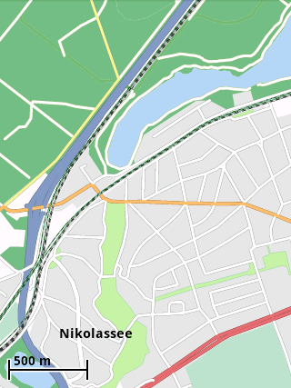
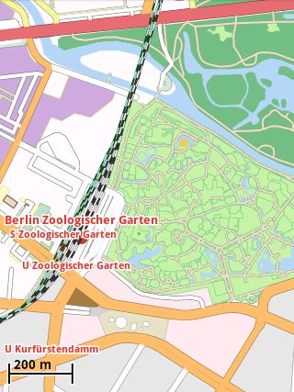
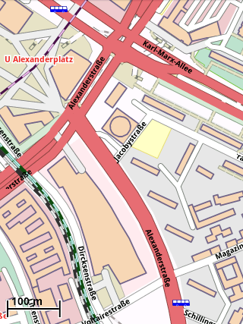
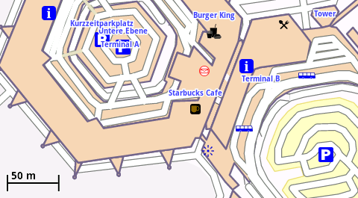
Screenshots of our map library
.

Slide 10
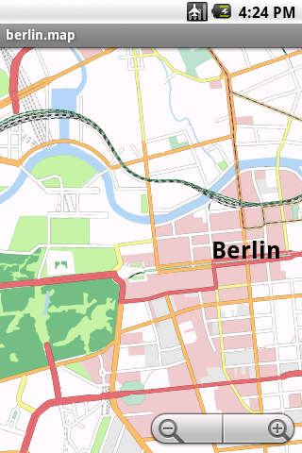
Our free map application for Android
Working title: AdvancedMapViewer
  Runs on all Android versions ≥ 1.5
  Uses our map library and MapView
  Serves as demo application and test case
Some features
  Select map file in a file browser
  Configuration via preferences
  Follow current GPS position
  Enter new coordinates
  Currently included languages:
  English, German, Finnish
You can download the APK file and several
preprocessed map files at our website

Slide 11
Hello, MapView (Google Version)
import android.os.Bundle;
import com.google.android.maps.MapActivity;
import com.google.android.maps.MapView;
public class HelloMapView extends MapActivity {
@Override
protected void onCreate(Bundle savedInstanceState) {
super.onCreate(savedInstanceState);
MapView mapView = new MapView(this, "Your Maps API Key");
mapView.setClickable(true);
mapView.setBuiltInZoomControls(true);
setContentView(mapView);
}
@Override
protected boolean isRouteDisplayed() {
return false;
}
}
AndroidManifest.xml:
<uses-permission android:name="android.permission.INTERNET" />

Slide 12
Hello, MapView (mapsforge Version)
import android.os.Bundle;
import com.google.android.maps.MapActivity org.mapsforge.android.map.MapActivity;
import com.google.android.maps.MapView org.mapsforge.android.map.MapView;
public class HelloMapView extends MapActivity {
@Override
protected void onCreate(Bundle savedInstanceState) {
super.onCreate(savedInstanceState);
MapView mapView = new MapView(this, "Your Maps API Key");
mapView.setClickable(true);
mapView.setBuiltInZoomControls(true);
mapView.setMapFile("/sdcard/berlin.map");
setContentView(mapView);
}
@Override
protected boolean isRouteDisplayed() {
return false;
}
}
AndroidManifest.xml:
<uses-permission android:name="android.permission.INTERNET" />
<uses-permission android:name="android.permission.WRITE_EXTERNAL_STORAGE" />
New!

Slide 13
What comes next
Map rendering module
  Improve various aspects
  Fix known issues with coastlines and large areas
  Implement Overlay API
  Use OpenGL for map rendering
    Hardware acceleration
    Better drawing controll
    Maps in 3D?
  Custom render styles and symbols
  Better label placement algorithms
Navigation modules
  Offline routing with turn-by-turn navigation
  Offline search and geocoding
Support for other platforms

Slide 14
Thank you!
http://mapsforge.org

